Slide 1



Blood Donor Database

Slide 2
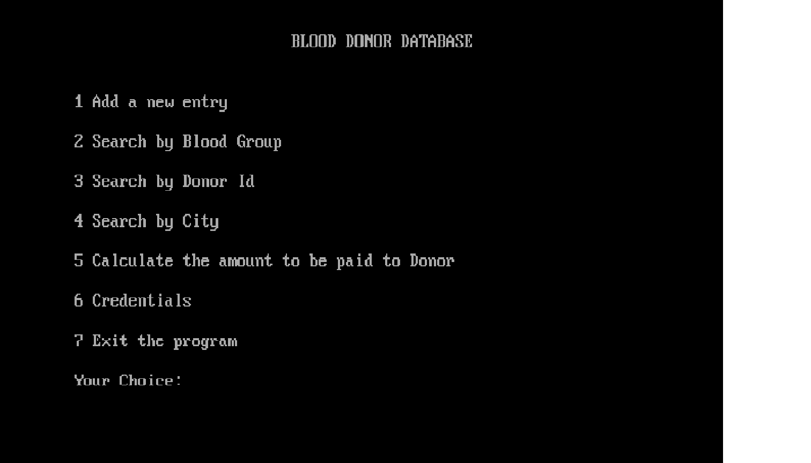

Slide 3
PREPROCESSORS
STDIO.H
CONIO.H
STRING.H
DOS.H
Notes:
Aiesha

Slide 4
User Defined Functions
Putdonor();
Getdonor();
Donorbyid();
Donorbycity();
Menu();
Calsum();
Creden();
Notes:
Chandan

Slide 5
Some In-Built Functions
STDIO.H | CONIO.H | STRING.H | DOS.H
Printf() | Clrscr() | Gets() | Delay()
Scanf() | Getch() | Puts()
Fread() |  | Strcmp()
Fopen()
Fwrite()
Fflush()
Notes:
Aman Kr. Singh

Slide 6
Emulator
We use linkfloat() as emulator.
The emulator that we have used is Floating Point Emulator.
A floating point emulator is used to manipulate floating point numbers in runtime library functions like scanf().

Slide 7
Files & Structures
A file pointer is Declared with name ‘fp’.
Structures is declared.
Variables inside structure are mostly char type nd int type.
Binary File is Used.
Notes:
akash

Slide 8

Problems
Linker Error. Program was not able to link float with the program.
Solution:- Use of function “linkfloat()”.
Storing Phone Number
Solution:- Use of String Data Type.
Taking garbage value during runtime input.
Solution:- Use of fflush(stdin)
Notes:
Anshika

Slide 9



Slide 10
The End

